Slide 1
Politics and Science: Examining the Role of Politics on Federal R&D Funding Allocations
Erik Lopez

Slide 2
How do changes in funding patterns reflect on the political changes?
Identify significant changes on what gets funded
Nationally vs State
Compare with political landscape
Congress Composition Percentages

Slide 3
Data & Methods
Federal Reporter
Funding amounts
State, congressional district
Gov’t department/agency
Congress.gov
Congressional District’s Political Party affiliation
Term duration
BeautifulSoup
Webscrape Congress.gov
Join on Congress District/State/Year
Calculate % change over time
Department
Agency
Find correlation
Party% vs Funding Change% per year
Detect abnormalities

Slide 4
Outputs & Policy Implications
Verify impact (or lack of) of political parties on funding
Are there champions for specific subject areas?
Identify federal R&D field interests
Implications:
Which fields are being neglected/prioritized?
Social priorities vs funding

Slide 5
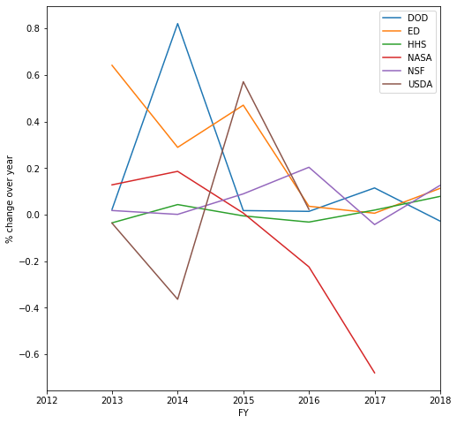
TODOs
Define what constitutes a significant funding change
More data before 2011
House Republican vs Dem Majority
Programmatically analyze funding at national/state level
How does it compare vs overall national
Do states have niche research areas?

